Slide 1
Temagami Boundary Review Presentation
Bunny Miller Theatre
Temagami, Ontario
October 16, 2013

Slide 2
Thanksgiving Prayer
Father in Heaven, Creator of all and source of all goodness and love, please look kindly upon us and receive our heartfelt gratitude in this time of giving thanks.
Thank you for all the graces and blessings You have bestowed upon us, both spiritual and temporal: our faith and religious heritage, our food and shelter, our health, the love we have for one another and our family and friends.
Dear Father, in Your infinite generosity, please grant us continued graces and blessing throughout the coming year.
This we ask in the Name of Jesus, Your Son and our Brother. Amen

Slide 3
Boundary Review Public Consultation Agenda
Prayer
Welcome
Boundary Review Terms of Reference
Boundary Review Committee Membership/Introductions
Purpose of the Boundary Review
NCDSB Guiding Principles
Boundary Review Committee Mandate
Background Information
Present School Boundaries
Public Consultation/Communications
Supporting Materials
Date and Purpose of Next Public Meetings
Community Input/Questions & Answers

Slide 4
Terms of Reference
  All BRC meetings are held in public;
  All audience members must register at entrance;
  No banners, placards, posters, photos will be displayed during the meeting as a means of influencing the committee;
  The meeting falls under the direction of the Chair and the Chair shall exercise such discipline as is necessary to maintain order.

Slide 5
Terms of Reference
Receiving Questions
  Only adults (voting age) will be permitted to address the BRC or ask questions;
  The designated microphone (if needed) will be used for questions from the floor;
  Audience members will be given two occasions to address the committee or ask questions in any one evening;
  Speakers addressing the BRC will identify themselves and their relationship to the process. They will have registered their attendance prior to asking their question;
  Questions or comments will not extend beyond two minutes.

Slide 6
BRC Membership
School Superintendent(s) of the affected school(s) or designate
Two parent representatives from each school
Principal from each school
Manager of Finance (if required)
Community Relations Officer
Two trustees (non-voting members)
North East Tri-Board Student Transportation Representative (if required)

Slide 7
BRC Committee Membership
Representing English Catholic Central School
Lori Hurtubise- Principal
Billie Richer– Parent Representative
Rachel Batisse – Parent Representative

Slide 8
BRC Committee Membership
Representing St. Patrick School
Chris Collins - Principal
Karen Lafreniere – Parent Representative
Todd Bosak– Parent Representative

Slide 9
BRC Membership
Representing Central Board Office
Glenn Sheculski – Director, Chair of BRC
Andrew Marks – Community Relations Officer
Mary Lou Pollon – Manager of Finance (resource person)
Debra Smith – Transportation Officer, North East Tri-Board Student Transportation (resource person)

Slide 10
BRC Membership
Representing Trustees (non-voting members)
Rick Brassard, Chair of the Board, Trustee for Kirkland Lake, Englehart
Martin Drainville, Trustee for New Liskeard, Haileybury and Cobalt

Slide 11
Purpose of the Boundary Review
Currently, Catholic students from Temagami are bussed to English Catholic Central School in New Liskeard rather than St. Patrick in Cobalt based on our current boundaries.
Should Temagami students be bussed to St. Patrick School in Cobalt rather than ECCS in New Liskeard?

Slide 12
Guiding Principles
The review process will be reflective of the Board’s Principles and Values as articulated in our Mission and Vision Statement:
NCDSB Vision Statement
Living our Catholic Faith to shape success for all of our learners.
NCDSB Mission Statement
To provide quality Catholic education to all of our learners, in a safe, nurturing, equitable and inclusive environment that prepares them for life.

Slide 13
Guiding Principles
NCDSB Belief Statements
We believe…
    in a publicly funded Catholic Education System;
    that our actions are guided by the teachings of our Catholic faith;
    that all students can reach their God-given potential given sufficient time and focused support;
    in excellence through a commitment to continuous improvement for all staff and students;
    in providing safe and nurturing environments for learning and working;

Slide 14
Guiding Principles
NCDSB Belief Statements
    in building positive relationships and partnerships with our parishes, parents and the broader Catholic Christian community. The support of parents, guardians and community members increases the learning opportunities for our students and assists staff in daily operations;
    that the stewardship of God’s gifts is a responsibility of all.

Slide 15
Guiding Principles
NCDSB Values
    Dignity and Respect for all
    Equity and Inclusivity
    Honesty
    Loyalty
    Personal and Communal Growth

Slide 16
Boundary Review Committee Mandate
Provide public with information.
Provide opportunity for community consultation through public meetings.
Study/Analyze the input/data received from all stakeholders.
Develop recommendation(s) on boundary options for Board consideration.
Present recommendation(s) for Board consideration.

Slide 17
Background Information
School/Category | ECCS | St. Patrick
Capacity | 302 | 187
Present Enrolment | 291 | 121
%age Capacity | 96 | 64
Available Pupil Places | 11 | 66
# of Temagami Students | 23 (8 FI) | 0
Distance from Temagami | 56 kms | 48 kms
Total Travel Time (one way) | 56 minutes | 43 minutes
Cost of Bus from Temagami | $449.35/day | $401.04 /day

Slide 18
Average Daily Enrolment (ADE) projections
School | 2013-14 | 2014-15 | 2015-16
ECCS | 219 | 193 | 172
St. Patrick | 107 | 97 | 93
Trend in Northern Ontario is declining enrolment.
Board needs to be fiscally responsible while at the same time, ensuring that all of our schools are viable.
Boundary reviews are a part of this process.

Slide 19
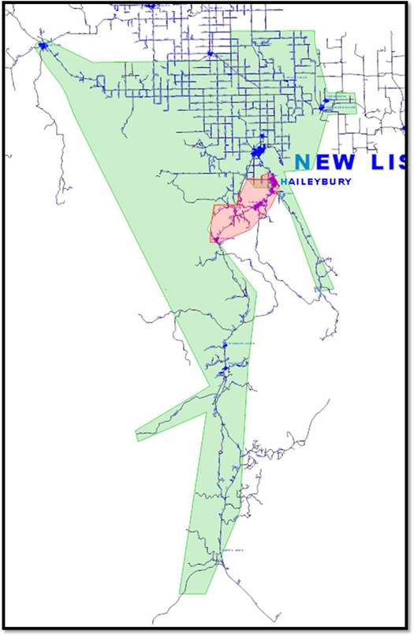
Present School Boundaries

Slide 20
Public Consultation/Communications
NCDSB website page with information
NCDSB website feedback form
NCDSB contact person to receive emails or phone calls
Media advisories/releases
Letter to School communities in affected regions
Letter to Parents directly affected by Boundary Review
Letter to all Parents regarding the Public meetings
scheduled for BRC at ECCS & St. Patrick Catholic School
Public Meetings in affected Boundary Review area
Public Board of Trustee Meeting

Slide 21
Support Materials
www.ncdsb.on.ca

Slide 22
Date and Purpose of Next Public Meetings
1st BRC Public Consultation meeting in Temagami ‐ October 16, 6:30 pm to 8:00 pm at the Welcome Centre
2nd BRC Public consultation meeting in Cobalt – October 21, 6:30 pm to 8:00 pm at St. Patrick Catholic School.
BRC Videoconference Meeting to compile Feedback and prepare written report October 21
Make BRC Report recommendations and decisions public
Present BRC findings & recommendations and Senior Staff comments to Board of Trustees at Oct. 30th Board of Trustees meeting - allow for public delegations to be heard by Board.

Slide 23
Community Input/Questions & Answers

